Slide 1
Web Advanced
Jest

Slide 2
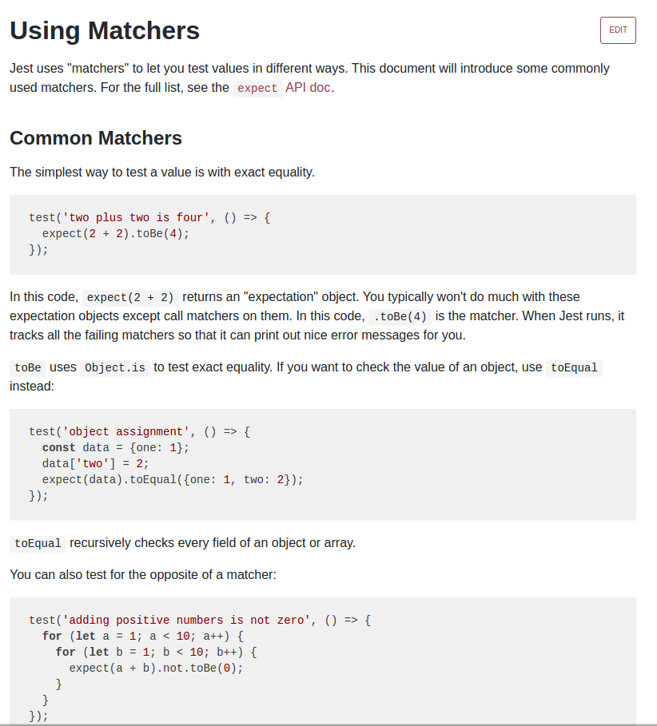

Slide 3
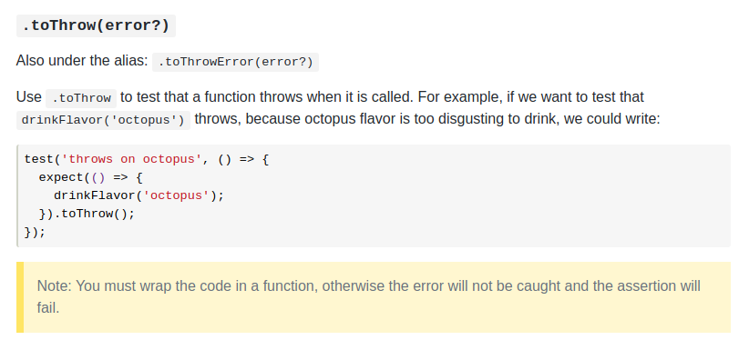

Slide 4
import Point from '../../../src/js/drawing/Point';
test('constructor to generate a Point object',
() => {
let point = new Point(1,1);
expect(point).toBeInstanceOf(Point);
});
test('constructor to throw error if 1st param. not a number',
() => {
expect(() => {
new Point("a", 1);
}).toThrow(Error);
});
test('constructor to throw error if 2nd parameter not a number',
() => {
expect(() => {
new Point(1, "a");
}).toThrow(Error);
});

Slide 5
test('getX to return the correct value',
() => {
let point = new Point(1, 2);
let x = point.getX();
expect(x).toBe(1);
});
test('toString to return the correct value', () => {
let point=new Point(1,2);
let returnedString = point.toString();
expect(returnedString).toBe("(1,2)");
});

Slide 6
describe: de 3 tests van de constructor worden samengevoegd
import Point from '../../../src/js/drawing/Point';
describe('constructor',
() => {
it('should generate a Point-object for valid args',
() => {
let point = new Point(1, 1);
expect(point).toBeInstanceOf(Point)
}
)
it('should throw error if 1st parameter is not a number',
() => {
expect(() => {
new Point("a", 1);
}).toThrow(Error)
})
it('should throw error if 2d parameter is not a number', () => {
expect(() => {
new Point(1, "a");
}).toThrow(Error)
})
}
);

Slide 7
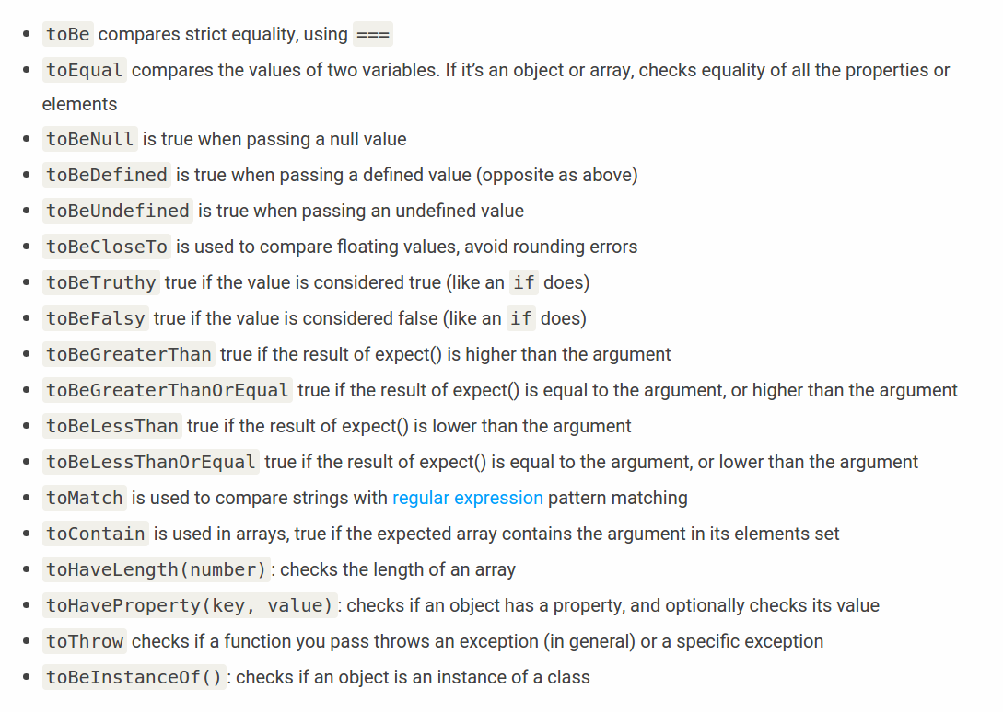

Slide 8
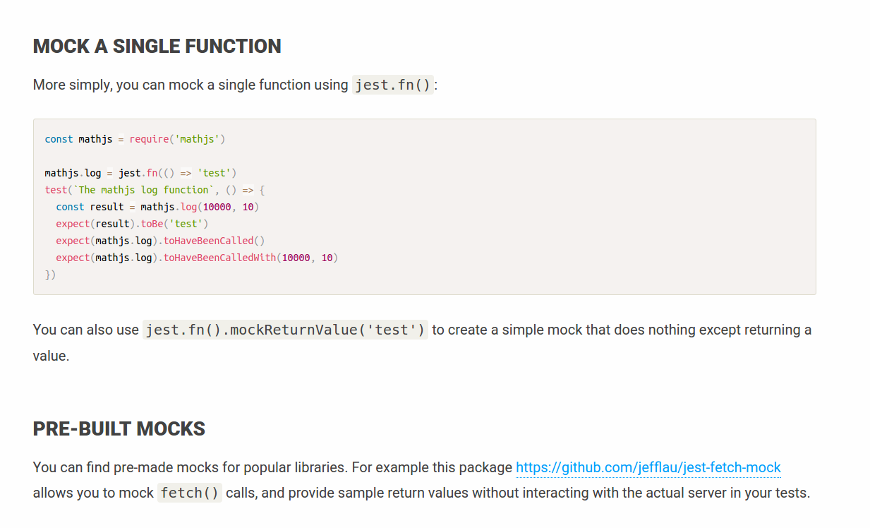
EXTRA

